Slide 1

高考历史大题
史论结合题

Slide 2
目录
基本介绍
评分标准
作答思路
拿分技巧

Slide 3
一、题型介绍

Slide 4
题型介绍
史论结合题
概括内容题
原因北京题
意义评价题
信息理由题
创新论文题
Notes:
心理学的交集
社会学的量化研究方法

Slide 5
Introduction · Core Focus
Effect of competition on unethical behaviors
Investigating the role of moral awareness, moral identity, and moral elevation

Slide 6
Introduction · Conception Clarification
Competition
A win-lose aspect
Rewards and evaluation
Cheating
Unethical acts
Create an unfair advantage for the actor
Notes:
Cheating is defined in our study as unethical acts intended to create an unfair advantage for the actor by generating rewards or valuable outcomes that the actor would not otherwise be entitled to receive

Slide 7
Introduction · Conception Clarification
Desire to win
Arousal theories of competition
Path: competitive pressure→ physiological arousal→ motivation towards beating competition even at a high cost
Moral awareness
Social cognitive theory
Path: external information→ encoding → perceivers’ mind
pays attention to incoming information and categorizes it as a moral issue
Bounded attention→ bounded ethicality(failure to process social information)

Slide 8
Introduction · Conception Clarification
Moral identity
Internal factor
personal moral standards
Moral elevation
External factor
individuals' attention is redirected outwards

Slide 9
Introduction · Framework
competition
cheating
Whether competition affects cheating
Why competition affects cheating
How competition affects cheating

Slide 10
PART 2: Empirical Study
Experiments
Field Study

Slide 11
Experiments · Overview 1
 | purpose | location | subjects | size | treatment | measure of competition | measure of cheating | desire to win | moral awareness
Study 1 | whether competition affects cheating | Mechanical Turk(online) US | mostly educated working adults | 71 | low-high competition | 10/30 *1 v.s. 3/30*4 manipulation check | sum of response for unsolvable questions | / | /
Study 2A | how competition affects cheating | Mechanical Turk(online) US | mostly educated working adults | 208 | low-high competition | 30/60*.5 v.s. 3/60*5 manipulation check | Gap between the actual and stated number | 1. I will do whatever it takes to win this competition. 2. I will do whatever it takes to get the rewards from this assignment. | 1. There are very important ethical aspects of this assignment 2. This task clearly does not involve ethics or moral issues and 3,4 empirical analysis
Notes:
查看效果：one-way anova
1-7分的量表
最后一列还有两个测量维度 两个都是取平均值
3. This situation deals with a moral or ethical issue 4. This task has nothing to do with ethics and morals
win-lose proportion; rewards

Slide 12
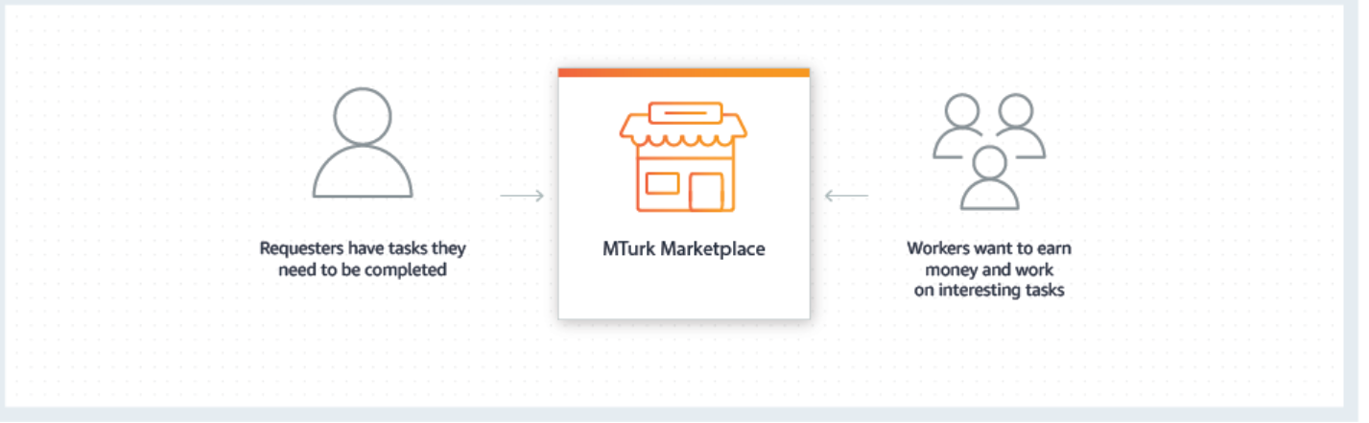
Experiments · Study 1
Mechanical Turk
back

Slide 13
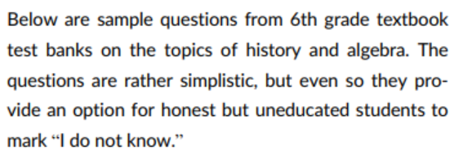
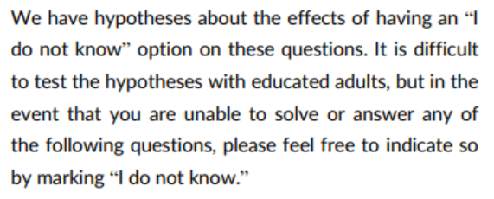
Experiments · Study 1
Measure of cheating
one out of 5 questions was unsolvable with nonsense words and symbols
what is the capitol of Kazhindstan?
(3X – 5]φ = 13; X =?
More specific instructions see:
The role of moral knowledge in everyday immorality: What does it matter if I know what is right? .
Notes:
Given the instructions, the response “I don't know” for the unsolvable questions was honest and was coded as “0.” Any other responses were considered dishonest and were coded as “1.”
Cheating was the sum of the responses

Slide 14
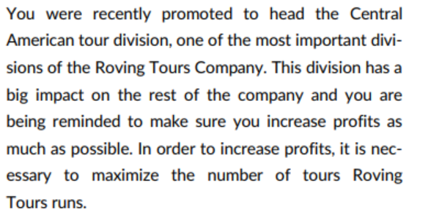
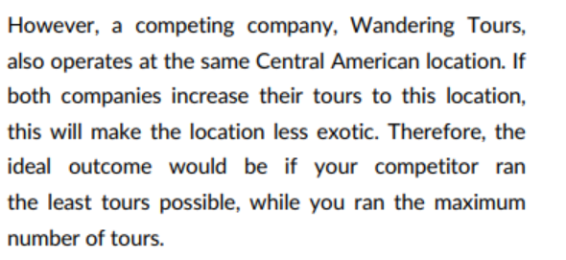
Experiments · Study 2A
Measure of cheating: prisoner’ s dilemma
Notes:
Given the instructions, the response “I don't know” for the unsolvable questions was honest and was coded as “0.” Any other responses were considered dishonest and were coded as “1.”
Cheating was the sum of the responses

Slide 15
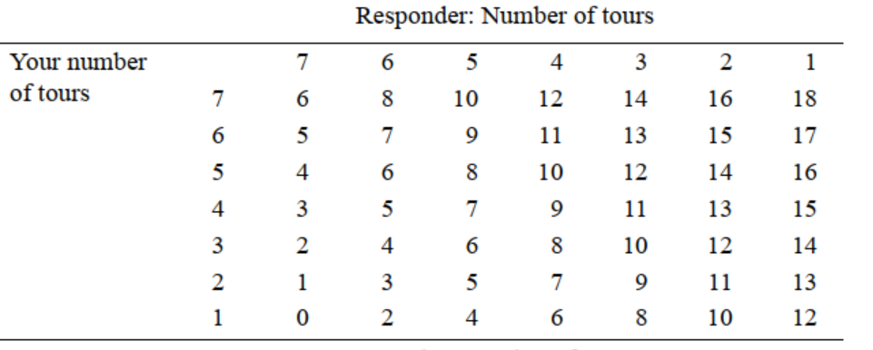
Experiments · Study 2A
Measure of cheating: prisoner’ s dilemma

Slide 16
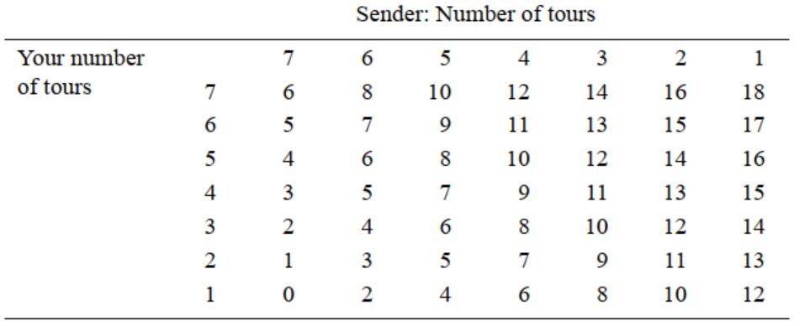
Experiments · Study 2A
Measure of cheating: prisoner’ s dilemma
More specific instructions see:
Conflict Frames and the Use of Deception: Are Competitive Negotiators Less Ethical?
back
Notes:
Participants in the study saw only part of this table. Senders saw the top half, and Respondents saw the bottom half. Numbers represent the projected profit for senders and responders (in $10,000~

Slide 17
Experiments · Study 2A
Cheating：the difference between the actual and stated number of tours
the number sender would actually run the following season
the number sender would report to the receiver
Note: the receiver would be only informed of the indicated information
back
Notes:
which was an act of creating an unfair advantage by participants for themselves and therefore a form of cheating

Slide 18


Experiments · Study 2A
Mediating effects: theoretical framework
Estimation of the direct and indirect effects in such a model requires k models of M from X
a single model of Y which includes all k M mediators plus X as predictors
Direct effects v.s. indirect effects
More technical details see:
PROCESS: A Versatile Computational Tool for Observed Variable
Mediation, Moderation, and Conditional Process Modeling.
back
Notes:
which was an act of creating an unfair advantage by participants for themselves and therefore a form of cheating

Slide 19
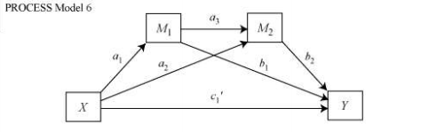
Experiments · Study 2A
Mediating effects: empirical verification
Competition impaired moral awareness, which explained why people cheated.
In contrast, the desire to win did not mediate these effects.
Possibility of serial mediation?
More technical details see:
PROCESS: A Versatile Computational Tool for Observed Variable
Mediation, Moderation, and Conditional Process Modeling.
Notes:
which was an act of creating an unfair advantage by participants for themselves and therefore a form of cheating

Slide 20
Experiments · Study 2A
Possibility of effects of procedure sequence?
Measure the mediating variable before providing the opportunity to cheat.
 | purpose | location | subjects | size | treatment | measure of competition | measure of cheating | desire to win | moral awareness
Study 2A | how competition affects cheating | Mechanical Turk(online) , US | mostly educated working adults | 208 | low-high competition | 30/60*.5 v.s. 3/60*5 manipulation check | gap between the actual and stated number | 1~7 scale items 1. I will do whatever it takes to win this competition. 2. I will do whatever it takes to get the rewards from this assignment. | 1. There are very important ethical aspects of this assignment 2. This task clearly does not involve ethics or moral issues and 3，4
Study 2B | test the effect of sequence of procedure | Mechanical Turk(online) , US | mostly educated working adults | 83 | low-high competition | 10/30*1 v.s. 3/30*4 manipulation check | spending more than 90s on the task
Notes:
This sequence of procedure limits the ability to conclude a causal direction because it is possible that self-reported desire to win and impaired moral awareness were post-hoc justifications for participants' cheating behavior. It is also possible that the arousal effect of competition may have dissipated by the time it was measured after the task.

Slide 21
Experiments · Study 2B
Measure of cheating
5 matrices with 4 rows and 5columns of 3-digit numbers
Find 2 numbers in each matrix that summed to 10
asked them to not spend more than 90 s, but it is not compulsory i.e. the browser did not automatically close after 90s.
Experimental result
Consistent with the above-mentioned studies
again found support for the mediating effects of impaired moral awareness, but not of desire to win
More specific instructions see:
The hungry thief: Physiological deprivation
and its effects on unethical behavior .

Slide 22
Experiments
competition
cheating
Whether competition affects cheating
Why and how competition affects cheating
→→Moderating effect?

Slide 23
Experiment · Study 3
 | purpose | location | subjects | size | treatment | measure of competition | measure of cheating | moral identity | moral elevation
Study 3A | test the moderating effect of social identity on competition-cheating relationship | India | MBA students | 105 | low-high competition | 40/105*2 v.s. 4/105*20 | gap between the actual and stated performance | 5 items from internalization scale(1_7points) | /
Study 3B | test the moderating effect of social identity on competition-cheating relationship | India | employees | 100 (in pairs) | low-high competition | 3 items capturing competitive levels, "everybody in my organization in concerned with finishing at the top" | 3 items to rate the frequency with which the focal employee engaged in various cheating behaviors | 3 items from deviance scale | /
Notes:
道德身份的量表：
The instructions for the measure were “Below are some characteristics that might describe a person: Caring, Compassionate, Fair, Friendly, Generous, Helpful, Hardworking, Honest, and Kind. The person with these characteristics could be you or it could be someone else. For a moment, visualize in your mind the kind of person who has these characteristics. Imagine how that person would think, feel, and act. When you have a clear image of what this person would be like, answer the following questions.” Sample items include “It would make me feel good to be a person who has these characteristics” and “Being someone who has these characteristics is an important part of who I am.”

Slide 24
Experiments · Study 3A
Measure of cheating
20 matrices with 4 rows and 5columns of 3-digit numbers
Find 2 numbers in each matrix that summed to 10
6 min to find the numbers
Correct answers would be presented after 6 min on the screen
After self-evaluating, hand in the reporting slip and recycle the solution sheet.
Cheating behavior: gap between self-reported and actual performance
back

Slide 25
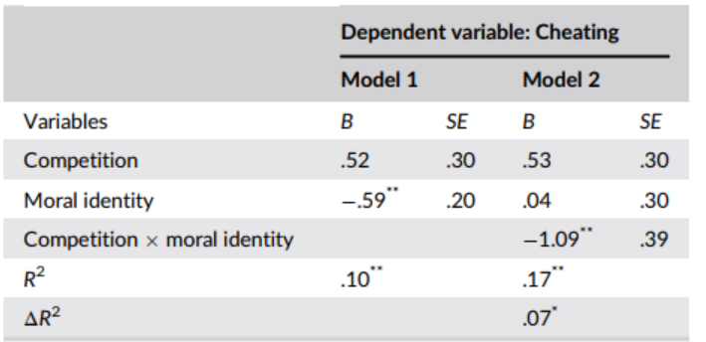
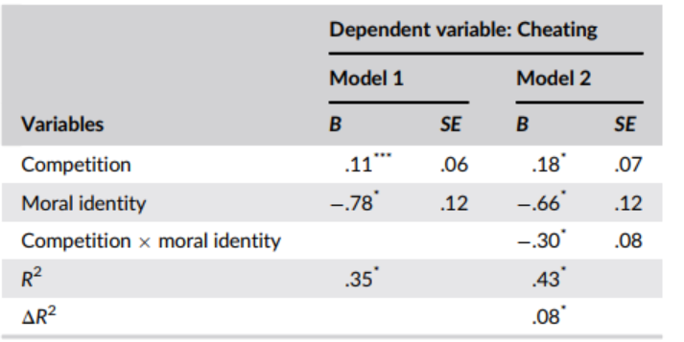
Experiments · Study 3
Study 3A (n=105)
Study 3B (n=100)
back

Slide 26
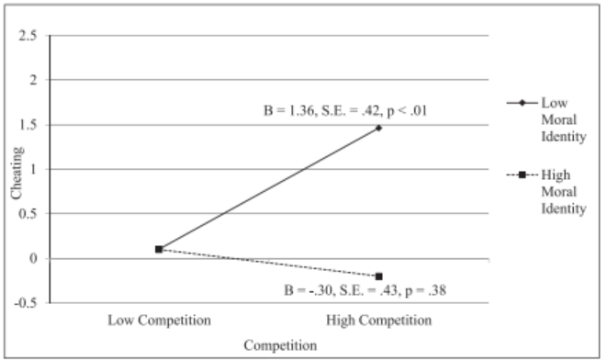
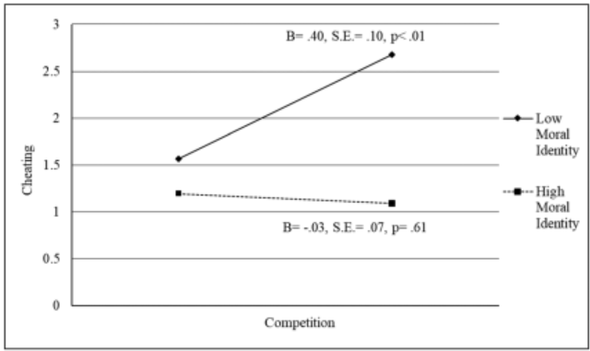
Experiments · Study 3
Study 3A (n=105)
Study 3B (n=100)
back

Slide 27
Field · Study 4
 | purpose | location | subjects | size | treatment | measure of competition | measure of cheating | moral identity | moral elevation
Study 3A | test the moderating effect of social identity on competition-cheating relationship | India | MBA students | 105 | low-high competition | 40/105*2 v.s. 4/105*20 | gap between the actual and stated performance | 5 items from internalization scale(1_7points) | /
Study 3B | test the moderating effect of social identity on competition-cheating relationship | India | employees | 100 (in pairs) | low-high competition | 3 items capturing competitive levels, "everybody in my organization in concerned with finishing at the top" | 3 items to rate the frequency with which the focal employee engaged in various cheating behaviors | 3 items from deviance scale | /
study 4 | test the moderating effect of social elevation on competition-cheating relationship | India | MBA students | 257 | 2x2 design low-high competition; low-high moral elevation | 40/257*2 v.s. 4/257*20 | gap between the actual and stated performance | / | video-evaluation check; scale items for 3-dimension components

Slide 28
Field · Study 4
Moral elevation
External factor
individuals' attention is redirected outwards
Emotional component
View of humanity
Desire to be a better person

Slide 29
Field · Study 4
Problem-solving task
Manipulate competition and assess cheating
Video evaluation task
Manipulate moral elevation
High moral elevation treatment: the child inspired others to help move the tree
Low moral elevation treatment: young adults were burning chairs

Slide 30
Field · Study 4
Moral elevation manipulation check
Emotional component
“I felt compassionate after watching the video”
View of humanity
“People are really good”
Desire to be a better person
“I need to do more to help other people”

Slide 31
Field · Study 4
Moral elevation manipulation check
Emotional component
“I felt compassionate after watching the video”
View of humanity
“People are really good”
Desire to be a better person
“I need to do more to help other people”

Slide 32
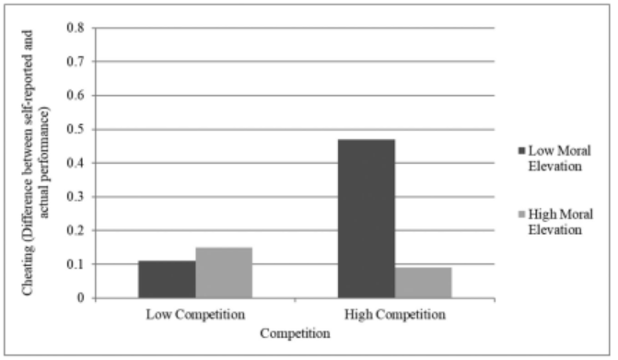
Field · Study 4
Study 4
Interaction effects of competition and moral elevation on cheating

Slide 33
Experiments and Field Study
competition
cheating
Whether competition affects cheating
Why and how competition affects cheating
Moderating effect: moral identity and moral elevation

Slide 34
PART 3: Further Discussion
Conclusion
Future directions

Slide 35
Further Discussion · Conclusion
Why competition affects cheating?
Moral awareness impairment instead of desire to win explains why people cheat in competition.
How competition affects cheating?
Moral identity and moral elevation both weaken the detrimental effects of competition on cheating.

Slide 36
Further Discussion · Future research
Casual inference of moderating effect ?
Unethical behavior v.s. mistaking behavior ?
Other measurements for cheating behavior?
Competition, relative rank and cheating behavior

Slide 37
Thanks for listening :)

